Slide 1
Graphical User InterFace
Final Project

Slide 2
Contents of This Presentation
Here’s what you’ll find in this Presentation:
Project overview - Description, tech stack, and purpose of the application
Application Entry Point
Database Configuration.
Flashcard Data Model
Business Logic
Data Validation
Routing
User Interface
Flexbox Grid style

Slide 3
01
Project Overview

Slide 4

The Flash Card Web App
This is a Flashcard Management Web App built with Node.js, Express, and Postgresql.
Users can create, view, and delete flashcards.
Uses EJS for templating and includes a basic GUI via HTML/CSS.

Slide 5
02
Entry Point

Slide 6
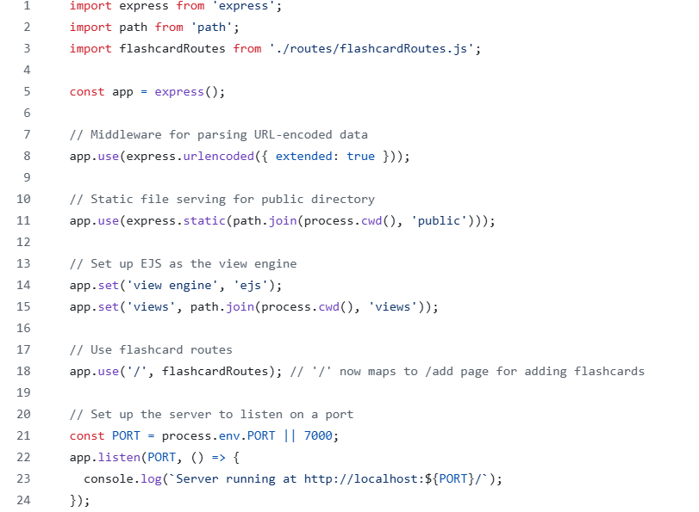
APP.js

Slide 7
Main Takeaways
Importing Required Modules
express: Web framework.
path: For resolving file paths.
flashcardRoutes: Custom route handler module.
Creating the Express App
const app = express();
Middleware for Form Data
app.use(express.urlencoded({ extended: true })); Parses URL-encoded data from forms.
Serving Static Files
app.use(express.static(path.join(process.cwd(), 'public'))); Serves files from the public directory (e.g., CSS, images).
View Engine Configuration
app.set('view engine', 'ejs'); Uses EJS as the templating engine.
app.set('views', path.join(process.cwd(), 'views')); Sets the directory for EJS views.
Routing Setup
app.use('/', flashcardRoutes); All base routes are handled through the flashcard routes module.
Server Initialization
const PORT = process.env.PORT || 7000; Sets the server port, using .env or default 7000.
app.listen(...) Starts the server and logs the address.

Slide 8
03
Database Configuration

Slide 9
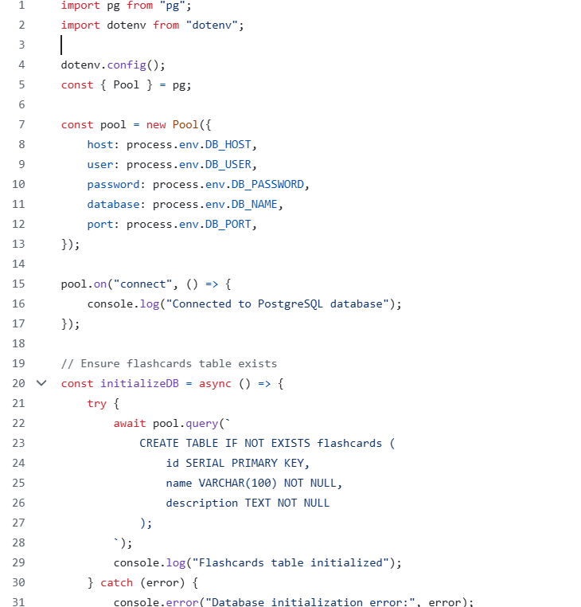
DB.js

Slide 10
Main Takeaways
Importing Dependencies
pg: PostgreSQL client for Node.js.
dotenv: Loads environment variables from a .env file.
Environment Configuration
dotenv.config(): Enables access to variables like DB_HOST, DB_USER, etc.
Creating the PostgreSQL Pool
Establishes a pool of connections using environment settings:
Host, user, password, database name, and port.
Connection Confirmation;
Logs a success message when the app connects to the database.
Database Initialization Function
Ensures the flashcards table exists.
Table schema:
id (Primary Key, auto-incremented)
name (required string)
description (required text)
Initialize the Table
initializeDB(); runs the setup at startup.
Exported Query Function
Wrapper for executing SQL queries elsewhere in the app.
Default Export
export default pool; allows using the pool directly when imported.

Slide 11
04
Flashcard Data Model

Slide 12
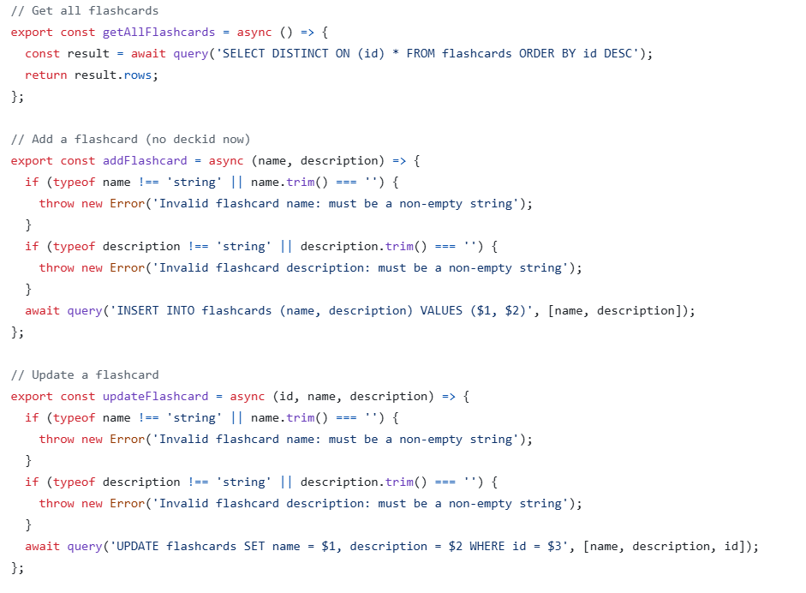
FlaschcardModel.js

Slide 13
Main Takeaways
Importing the Database Query Function
import { query } from '../config/db.js'; Imports the reusable query method to interact with PostgreSQL.
Get all Flashcards
Executes a SELECT DISTINCT ON (id) SQL query to fetch all flashcards.
Orders results by id in descending order.
3. Add a New Flashcard
Validates input (name and description must be non-empty strings).
Inserts new flashcard using parameterized SQL query.
4. Update an Existing Flashcard
Validates inputs similarly to addFlashcard.
Updates the flashcard’s name and description based on its id.
5. Delete a Flashcard
Deletes a flashcard by its unique id.

Slide 14
05
Business Logic

Slide 15
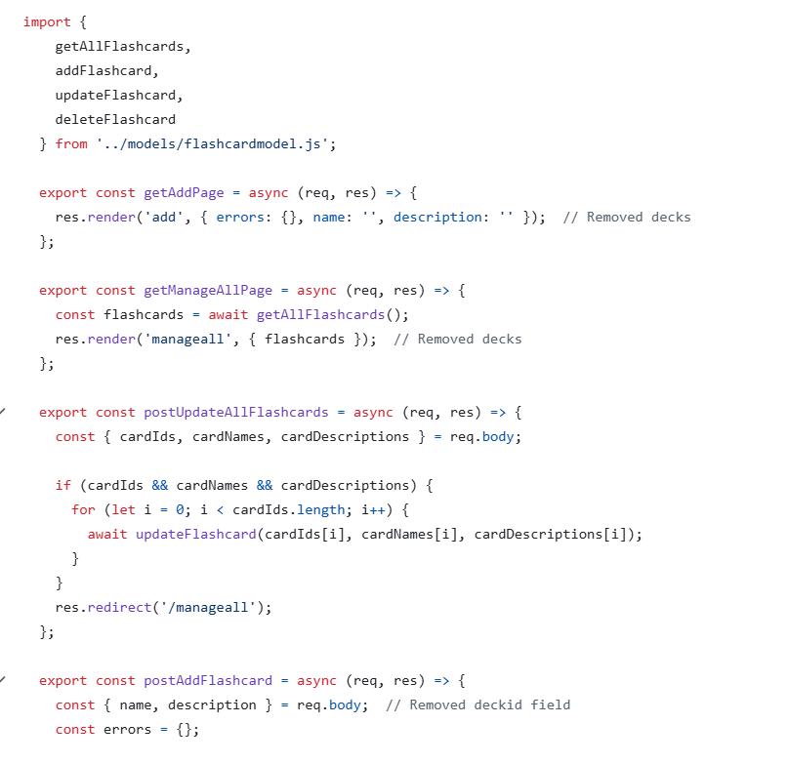
Flashcard Controller.js

Slide 16
Main Takeaways
Page Rendering for Add Flashcard
getAddPage renders the add.ejs template for adding new flashcards.
Displaying All Flashcards for Management
getManageAllPage and getManagePage both fetch all flashcards and render respective views (manageall.ejs, manage.ejs).
Batch Update of Flashcards
postUpdateAllFlashcards loops through arrays of flashcard data to update multiple records at once.
Adding a New Flashcard
postAddFlashcard handles form submission and, upon success, redirects to the /add page.
Single Flashcard Update and Delete
postUpdateFlashcard updates one flashcard by id.
postDeleteFlashcard deletes a flashcard using the id from the route parameter.

Slide 17
06
Data Validation

Slide 18
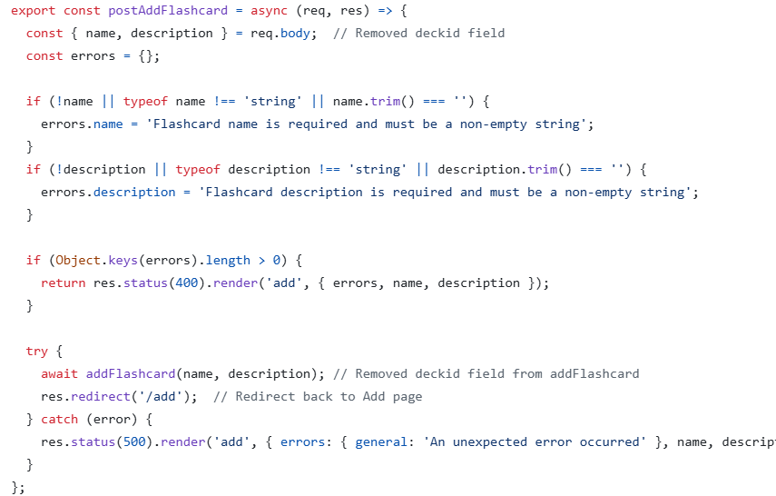
Flashcard Controller.js (Data Validation)

Slide 19
Main Takeaways
Extracts Input Values
Pulls name and description from the request body.
Checks for Missing or Invalid Data
Verifies name and description are non-empty strings.
If invalid, adds appropriate error messages to the errors object.
Renders Form with Errors
If validation fails, re-renders the add.ejs page with:
Error messages.
Pre-filled values (so the user doesn’t lose their input).
Continues to Add Flashcard if Valid
If there are no errors, the flashcard is inserted into the database.
Handles Unexpected Errors Gracefully
If a server/database error occurs, a generic error message is shown on the form.

Slide 20
07
Routing

Slide 21
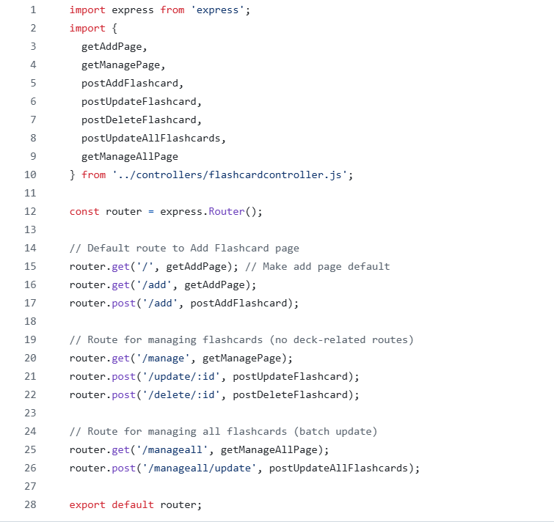
Routes.js

Slide 22
Main Takeaways
Route Definitions:
The file defines several routes using express.Router() to manage flashcards.
Default Route for Add Flashcard Page:
The get route for / and /add leads to the getAddPage controller, displaying the page to add a flashcard.
Add Flashcard:
The post route for /add triggers the postAddFlashcard controller, handling the submission of a new flashcard.
Manage Flashcards:
The get route for /manage displays the page to manage flashcards, while the post routes /update/:id and /delete/:id allow for updating and deleting individual flashcards.
Manage All Flashcards:
The /manageall route displays a page for managing all flashcards, and the post route for /manageall/update is used for batch updating flashcards.

Slide 23
08
User Interface

Slide 24
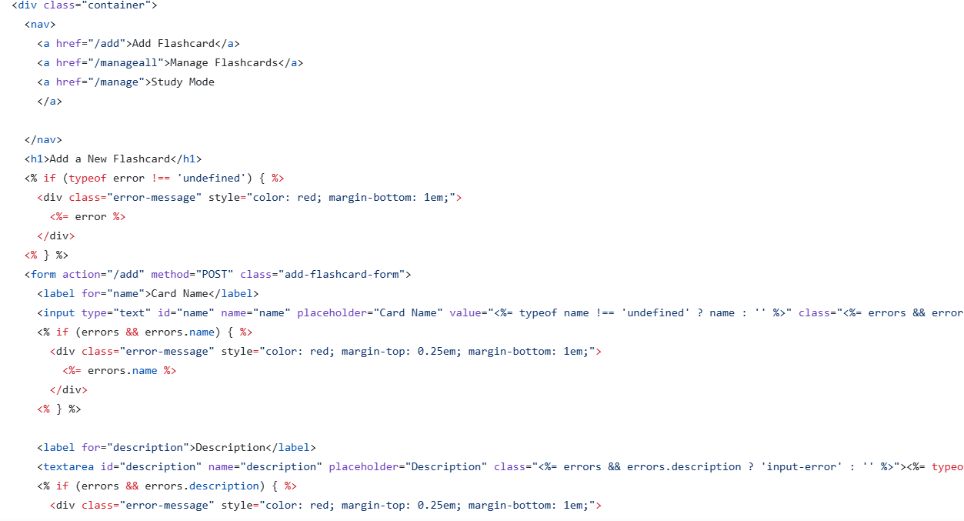
EJS FILES

Slide 25
09
GRID and FLEXBOX

Slide 26
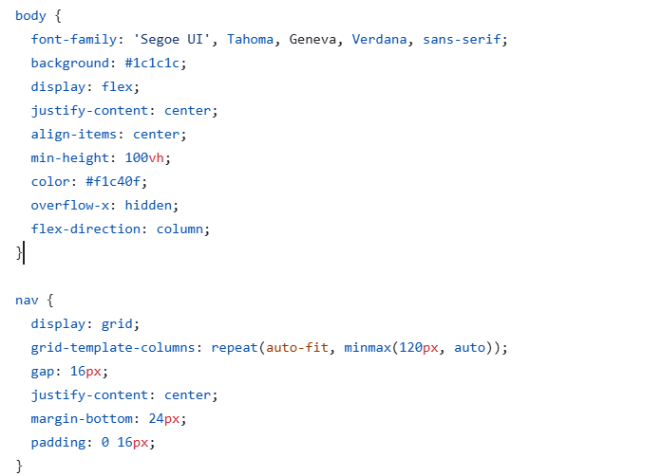
CSS File

Slide 27
Main Takeaways
body
How used: display: flex; justify-content: center; align-items: center; flex-direction: column;
Why used: To vertically and horizontally center the entire page content and stack it in a column layout.
.card-inner, .front, .back
How used: display: flex; align-items: center; justify-content: center;
Why used: To center the flashcard content (both front and back) in the middle of each card.
nav
How used: display: grid; grid-template-columns: repeat(auto-fit, minmax(120px, auto)); gap: 16px;
Why used: To create a responsive navigation bar where links automatically wrap and resize based on screen width.
.flashcard-stack
How used: display: grid; place-items: center;
Why used: To center the flashcard within the stack container both vertically and horizontally using concise grid utility.

